Slide 1

5.A. New Business
Municipal Budget Overview - FY2026

Slide 2
BUDGET CALENDAR
Monthly Budget Report
March Departmental requests/reviews
April Proposed budgets submitted by Department Heads
May Budget workshops
June
30 Certifications of taxable value by Property Appraiser (Form DR 420)
July
Town Commission Meeting – Draft budget within 60 days of budget year; set proposed millage rate and approve stormwater assessment roll.
30 Notification to Property Appraiser of the proposed millage rate, rolled-back rate, and date, time and place of the tentative budget hearing (DR 420)
August
NLT Property Appraiser mails notice of proposed property taxes (DR 474 TRIM Notice)
September (dates are based on the School Board and BOCC budget schedules)
? First public hearing – tentative millage rate and budget
? Advertise the tentative budget and millage rate
? Second public hearing – adopt final millage rate and budget
? Email copy of millage and budget resolution to Property Appraiser, Tax Collector, and Department of Revenue.
? Complete and certify From DR 422 within three (3) days of receiving from the Property Appraiser and submit back to Property Appraiser.
October
Complete and submit Form DR 487 with TRIM compliance package within 30 days following the final budget hearing.

Slide 3

MELBOURNE BEACH CODE
15-2. PREPARATION AND SUBMISSION.
The Town Manager, at least 60 days prior to the beginning of each budget year, shall submit to the Town Commission a recommended budget and an explanatory budget message in the form and with the contents provided for in this chapter.
15-4. CONTENTS OF RECOMMENDED BUDGET.
(b) Budget summary.
(c) Anticipated revenues; comparison with other years.
(d) Proposed expenditures; comparison with other years.
(e) Revenues and expenditures explained. The total of anticipated revenues shall equal the total of proposed expenditures.
(f) Capital improvement program (CIP). Along with the proposed budget, the Town Manager shall prepare a plan describing all recommended capital projects to be undertaken within the budget year and within the following four next succeeding years. Such capital improvement program shall list each capital project of $10,000 or more and a useful life of five years or more, indicating proposed or alternative funding sources.

Slide 4
The International City/County Management Association (ICMA) recommends local governments maintain significant reserves, ideally equivalent to six months of general fund operating expenditures, as a minimum for financial stability, a stronger guideline than older standards. This guidance helps ensure funds are available for unexpected needs, prevents "raids" on reserves, and is also valued by bond-rating firms, which often look for reserves covering at least 5% of annual operating costs.
Key ICMA Recommendations:
Adequate Reserves: Aim for at least 6 months of general fund operating expenses.
Financial Stability: Reserves are crucial for weathering financial challenges and maintaining services.
Why This Matters:
Resilience: Protects against economic downturns or unforeseen emergencies.
Credibility: Shows fiscal responsibility to residents, taxpayers, and investors.
Proactive Management: Prevents reliance on emergency borrowing or cutting essential services.
Government Finance Officers Association (GFOA) -recommended reserves, primarily for state and local "rainy day" funds, generally suggest holding at least two months (around 16-17%) of general fund operating expenditures for fiscal stability against recessions or disasters
GFOA Recommendation: Maintain unrestricted fund balances equal to at least two months of regular operating revenues or expenditures.
Percentage Target: This often translates to about 16.7% of annual revenue, with some experts suggesting aiming for 15% or higher.
Policy-Driven: Formal policies should consider revenue predictability, disaster risk, and have clear rules for deposits, withdrawals, and replenishment.

Slide 5
DEBT VS. ASSETS
TOWN'S BOND DEBT | BALANCE | PAYOFF
Stormwater Bond (Tax Assessment) | $66,707.20 | 9/30/2026
Municipal Bond GF | $448,450.00 | 10/1/2029
 | $515,157.20
“The assets of the Town of Melbourne Beach exceeded its liabilities at the close of the 2024 fiscal year by $13,032,089 (net position).” James Moore & Co., P.L., Financial Auditors, March 2025

Slide 6
BANK ACCOUNTS
+/- $6M UNASSIGNED
TOWN BANK ACCOUNTS | BALANCE | INTEREST RATE
OPERATING CHECKING ACCT | $ 4,938,343.34 | 1.50%
RESERVE ACCOUNT | $ 2,491,554.33 | 1.72%
SBA PRIME ACCOUNT | $ 538,876.07 | 3.99%
TOTAL | $ 7,968,773.74

Slide 7
OPERATING ACCOUNTS REVENUE
Operating Account Revenues | Amount
Property Taxes | 3,072,397.00
Sales and Use Taxes | 372,000.00
Franchise and Utility Taxes | 315,000.00
Public Service Taxes | 366,730.00
Insurance Premium Tax (Police Pension) | 50,000.00
State Revenue Sharing | 103,000.00
Investment Earnings | 40,000.00
Miscellaneous Revenue | 3,300.00
Operating Grants | 10,000.00
Licenses & Permitting | 263,450.00
Fines & Forfeitures | 27,000.00
Services | 75,500.00
Business Tax / Beverage License | 17,400.00
Local Option County Gas Tax | 99,548.00
From Reserve - TM Leave Payout | 33,481.00
From Reserve - Paid Fire Fighters | 188,780.00
From 172 to 001-21 (Police) | 80,934.00
From 172 to 001-22 (Fire) | 50,000.00
Disposal of Assets - Fire Truck | 125,000.00
TOTAL | 5,293,520.00

Slide 8
OPERATING ACCOUNT BUDGETED EXPENDITURES – GENERAL FUND
Operating Account Expenditures - GENERAL FUND
Town Hall | 1,467,708.00 | 28%
Police | 1,602,817.00 | 30%
Fire | 699,738.00 | 13%
Code | 71,452.00 | 1%
Public Works | 483,998.00 | 9%
Building | 233,204.00 | 5%
Transfer to Fund 341 | 510,706.00 | 10%
Transfer to Fund 351 | 52,000.00 | 1%
Transfer to LTC | 59,222.00 | 1%
Transfer to 201 - Bond | 110,175.00 | 2%
Transfer to other Funds | 2,500.00 | 0%
TOTAL EXPENDITURES | 5,293,520.00

Slide 9
CAPITAL IMPROVEMENTS FROM GENERAL FUND
CAPITAL FROM GENERAL FUND to OTHER FUNDS
Short Term | $118,860.00
Long Term | $59,222.00
Stormwater | $510,706.00
Roads | $52,000.00
TOTAL | $740,788.00

Slide 10
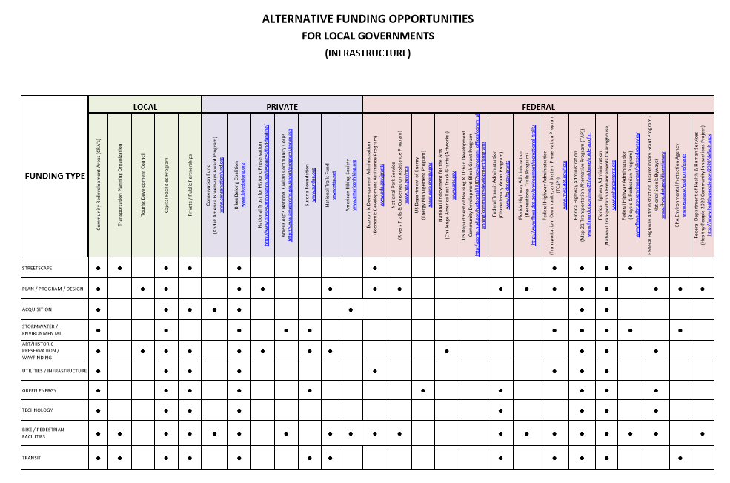

Additional Revenue Sources
Grants
SPECIAL Assessments
Service Fees
PERMIT & LICENSE FEES
FINES
PARKING FEES
Investment INCOME
BONDS

Slide 11

INVEST IN STAFF
Base salaries over 20% less on average than other Brevard County municipalities of similar size
Offer zero cost/low-cost incentives: time off (administrative); credit card points to provide gift cards;
Training/school; Auto allowance; Insurance health lifestyle benefits
FY25 Salary Comparison-Current Year
Municipality | PROPOSED FY26 COLA | PROPOSED FY26 MERIT | City Mgr | City Clerk | Finance Director | Public Works Director | Deputy Chief | Police Chief
Melbourne Beach | 3% |  | $ 119,101.60 | $ 66,274.14 | $ 73,329.99 | $ 67,260.44 | $ 82,149.00 | $ 108,694.00
Indialantic | 3% | 1-3% | $ 142,039.47 | $ 73,000.00 | $ 95,974.01 | $ 99,834.00 | $ 103,174.00 | $ 113,782.54
Indian Harbour Beach | 1.0% | 3% | $ 156,896.25 | $ 103,693.38 | $ 130,000.00 | $ 106,203.34 | $ 121,954.33 | $ 149,267.07
Satellite Beach | 5% |  | $ 161,000.00 | $ 106,383.02 | $ 83,396.35 | $ 127,154.41 | $ 115,199.63 | $ 136,677.00
Grant- Valkaria |  |  | $ 127,050.00 | $ 77,151.69 | $ 77,151.69
Malabar |  |  | $ 108,675.00 | $ 59,771.25 | $ 67,275.00 | $ 54,807.55
% Difference of Median |  |  | -12.50% | -22.60% | -19.80% | -35% | -28.50% | 16.90%
Median |  |  | $ 135,800.00 | $ 81,050.00 | $ 87,854.00 | $ 91,051.00 | $ 105,620.00 | $ 127,105.00

Slide 12

BUDGET CONSIDERATIONS
CONSIDER THE ENTIRETY OF FUNDS TO MEET BUDGET REQUIREMENTS
FOLLOW GOVERNMENT FINANCE RECOMMENDATIONS
ESTABLISH UNASSIGNED FUNDS BASED ON OPERATING BUDGET
PLACE UNASSIGNED FUNDS IN HIGH YIELD SAVINGS ACCOUNT
SEPARATE OPERATING FROM CIP
ADOPT CIP PLAN EACH YEAR ON A FIVE-YEAR SCHEDULE
INVEST IN TOWN INFRASTRUCTURE – COST SAVINGS IN MATERIALS, INSURANCE AND DISASTER RESILIENCY, PROACTIVE VS. REACTIVE
PURSUE ALTERNATIVE FUNDING RESOURCES AS PART OF CIP: FEE ASSESSMENTS, GRANTS, SERVICE FEES, INVESTMENT INTEREST
SET ASIDE SAVINGS EACH YEAR TO BUILD RESERVES
INVEST IN STAFF: LOW COST/NO COST INCENTIVES

